Slide 1
Using Google Forms for Virtual Class Tests: Copy and Rename, Send to Students, and View Scores

Slide 2
Using Google Forms for Online Class Testing
The online exam was created using Google Forms and is stored on Google Drive.
Each flotilla must copy and RENAME the master template version before using the test.
Flotillas MAY NOT add, delete, personalize, or change anything on the template or settings.
Notes:
The E-Directorate version of the exam includes your state’s required questions.
The first step toward using the exam with your students is to get the exam copy off the E-Dir Google Drive shared file and then place the copy into your own drive folder. If you do not do this first step, your version will also be on the E-Dir drive possible replacing the original test. That is to be avoided. It is very important that once you receive the exam you
Make a copy AND
rename your local copy
Drag your renamed copy from your ‘Shared with Me” folder into your “My Drive” folder. You can now remove the test in the “Shared with Me” folder.
DO NOT EDIT, REMOVE, PERSONALIZE, OR CHANGE ANY SETTINGS on the exam.
If you do not do the above steps, any potential edits you make will simultaneously be made to the master test on the E-Directorate copy because they reside in a shared environment. The purpose of Google Drive is to allow many people to see and edit documents together. We do not want that to happen to the core exam, so it’s very important to copy the exam to your google drive following the above directions.

Slide 3
Use Google
Notes:
This step may be obvious, but make sure you are using Google as your search engine, not Yahoo, Bing, or other start pages. The Browser does not matter. You can use Chrome, Safari, IE, etc. as the browser, but your start page needs to be Google.

Slide 4
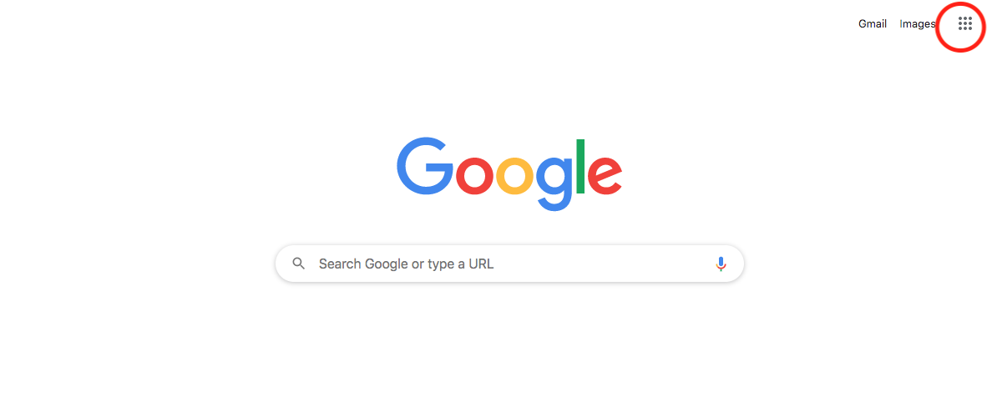
Use of Google Drive
Notes:
Open your Gmail account. You should see this screen. Click on the box of dots circled at the upper right side of your screen. It will open the selection of Google Apps available.

Slide 5
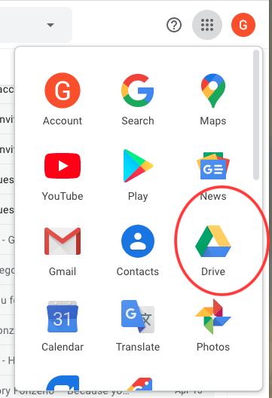
Use of Google Drive
Notes:
Click on your Google Drive icon. When you receive the email with the test, do not download the test directly from that email. Go to your Google Drive in this location and open it. You will see the test in the “Shared with Me” Folder in the drive itself.

Slide 6
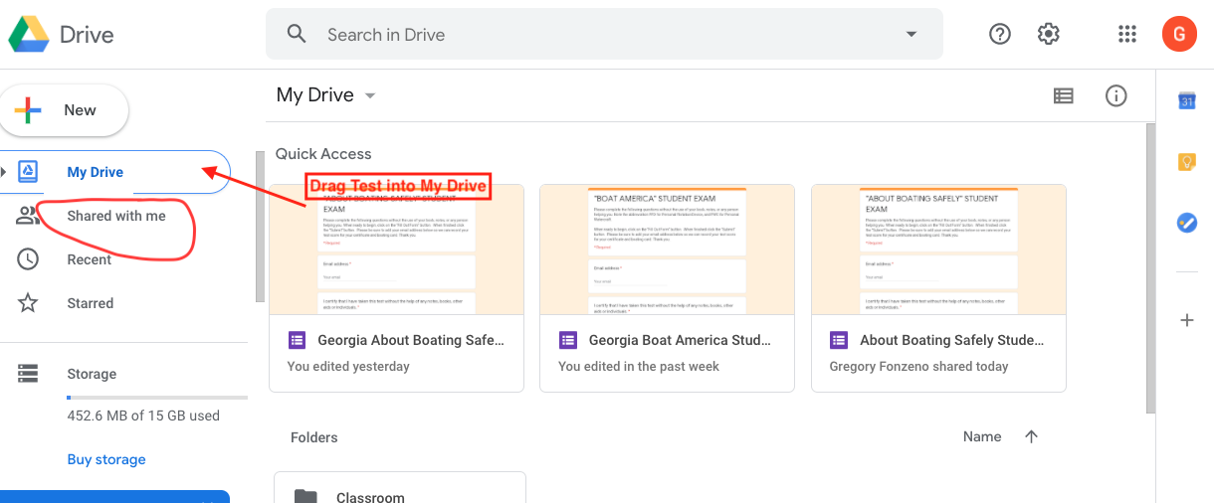
Use of Google Drive
Notes:
In “Shared with Me” you should see the test. Drag the test into the “My Drive” file. Then click on “My Drive” and you should see it. You will still need to rename it to avoid the E-Directorate Master copy getting your edits later. It is important to understand that you will not “download” a document in the traditional manner. Google Drive was established for several people to “share” and edit documents simultaneously. Because of this you MUST copy the document and then RENAME it in your folder; otherwise, all your changes will appear on everyone else’s document.

Slide 7
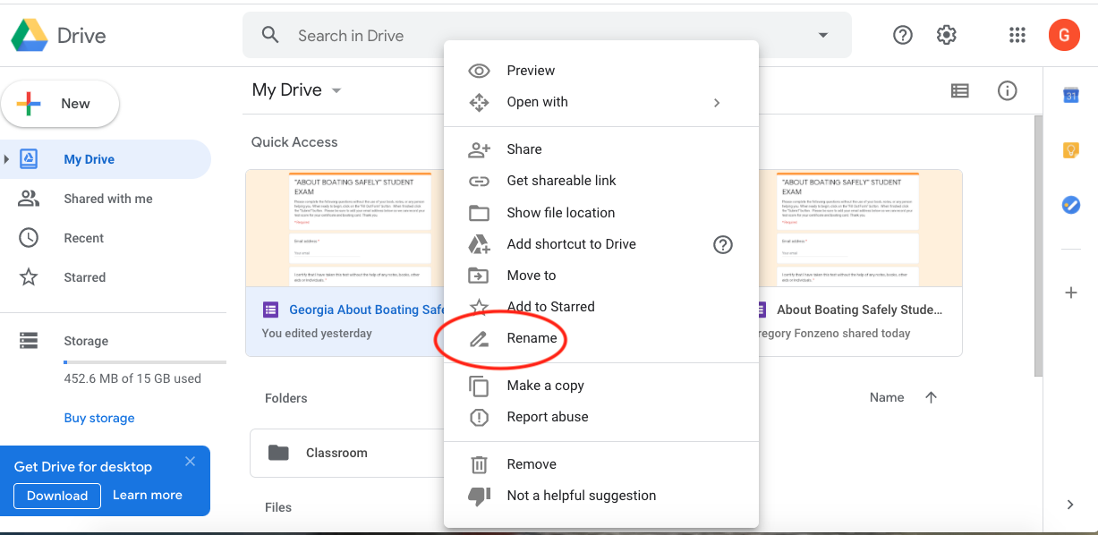
Use of Google Drive
Notes:
To make a copy and rename your test, right-click on the test to open Options. First Choose “Make a Copy.” When you see the copy of the test, right click on the copy then choose “Rename” and rename your test to avoid duplication of your edits onto the E-Dir. master copy. Once renamed, you can now edit and customize your test. You can also click on the original test and choose “Remove” which leaves only your renamed copy in your drive.

Slide 8
Caution: Edits are Auto Saved: There is no Undo!
Notes:
Unlike a Word document, any changes made to Google Forms is automatically saved to the document. There is no delete nor “undo.” Once you begin to play with the questions, you will have to rewrite it to put it back to its original version. You should not actually change or add anything to this test or its settings. Especially DO NOT DELETE student Email Address or you will not see their test results!

Slide 9
Send to Students
Notes:
The “Send” button on the upper right of the test is what allows you to send the test to students.

Slide 10
Sending the Test Using Chat Messaging
Notes:
Here you will see several options to send the test to students. The easiest and safest method is as a link that will paste into the “chat” program on your virtual platform. This is the option you should choose. If you wish, on the “Message” line you can customize your message to the student to invite them to take the test.

Slide 11
Sending the Test Using Chat
Notes:
To send the test through the “Chat” portal while online:
Click on the hyperlink icon;
Then click on “Shorten URL;
Copy the link
Then paste it into the “Chat” link to Everyone in your Zoom, Go-to-Meeting, or whichever virtual meeting platform you are using.
Once the students have the link, have them click on the link in their chat message and begin taking the test

Slide 12
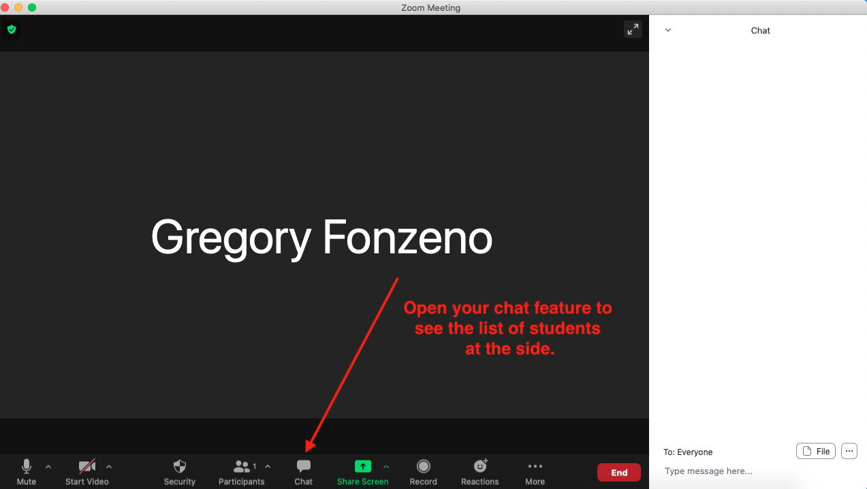
Sending the Test Using Chat
Notes:
This same is using ZOOM, but you will do the same no matter the platform used.
After you have copied the test link as shown in the previous slides, go to your meeting platform;
Open your chat feature;
Choose “everyone” in your chat list;
Then paste it into the “Chat” link to Everyone in your Zoom, Go-to-Meeting, or whichever virtual meeting platform you are using.
Once the students have the link, have them click on the link in their chat message and begin taking the test.
As much as we like to sometimes set-up our class in advance…do not link the test into the chat feature until you have all the students online, otherwise there is no one to receive the chat link!!

Slide 13
Sending the Test Using Chat
Notes:
This same is using ZOOM, but you will do the same no matter the platform used.
After you have copied the test link as shown in the previous slides, go to your meeting platform;
Open your chat feature;
Choose “everyone” in your chat list;
Then paste it into the “Chat” link to Everyone in your Zoom, Go-to-Meeting, or whichever virtual meeting platform you are using.
Once the students have the link, have them click on the link in their chat message and begin taking the test.

Slide 14
Student View
Notes:
The students will receive an invitation to take the exam. Once they click on “Fill Out Form’ the exam will appear to begin the test. Your customized message is seen.

Slide 15
Student Test Screen
Notes:
Students will type their email into the space provided. This is set as a required item and the student will not be able to proceed with the test until their email is completed. This will allow you to keep a record of student emails you can access later if you desire.

Slide 16
Submit Test
Notes:
Once students complete the exam, they will “Submit” the test. This sends it to immediate scoring.

Slide 17
Student Receipt
Notes:
The student receives notification that the test has been scored. You will need to respond to the student with their score. Students do not see their score. You can either email or send a chat to them with their score. It is important that you never allow the scores to be sent to the student. This option also sends them a copy of the test. If you allow the score to be included in this response, all the questions will be sent as well. We do not want the test to be available.

Slide 18
Student Responses
Notes:
To view scores, you will need to open your copy of the test and then click on the “Response” item on the page.

Slide 19
Response Views
Notes:
If you open the Responses tab above, you can view test data. “Summary” provides the average, median, and range of all the scores. “Question” will tell you which questions gave the students the most trouble. This option will be useful to help focus some of your teaching on more complicated information. “Individual” will provide you each student’s individual score by email address.
Once a student submits their test, you will begin to see their scores appear on the “Results” in the “Summary” section. As you scroll down you will see the list of students and their test score. You will need to email the student to inform him or her of the results. The results are not automatically returned to the students. To do so is to also allow a copy of the test to remain in their email. This is to be avoided for test security reasons.

Slide 20
Thank you
Using Google Forms:
Copy and Rename,
Send Test to Students, and View Scores
Requests for tests can be sent to:
gregory.fonzeno@cgauxnet.us
Please include the state you need
included with the exam.
Notes:
Thank you for your attention.

